Slide 1
Papua New Guinea
Abel Derderian
English presentation

Slide 2
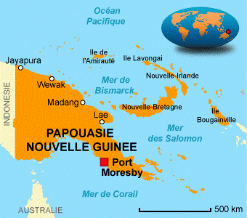
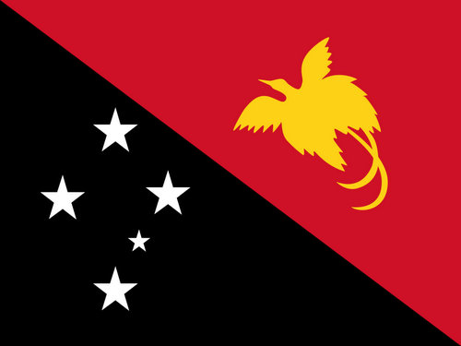
About the Papua New Guinea
Geographical location
…
And the flag
Real name : Independent State of Papua New Guinea
« puwah-puwah » (Malay, ‘Frizzy’)
« New-Guinea » : Spanish explorator (Equatorial Guinea)

Slide 3
A bit of history
Colonized by the Australia for the Great Britain in 1883
Then colonized by the germany in 1884,
Independant member of the Commonwealth since 1975.

Slide 4
Political History
Papua New Guinea now obeys the Queen of England, Elizabeth II.
Many conflicts took place between 1960 and 1980 against the power in place.
A lot of landowner, hated by the citizens.
Mine of Panguna

Slide 5
Ressources of the island
1973 : Mine of Panguna
2010 : Natural gas founded, but technicaly inexploitable.

Slide 6
Conclusion
Thank you for your attention.
Feel free to ask, if you have any questions. ☺

