Slide 1
London

Slide 2
The (quick) history of London
2000 years ago, founded by the romans First name : Londinium.
Inner London + Outer London = More than 9’000’000 inhabitants.
Hosted three times the Olympics games (1908 / 1948 / 2012).
First financial center in the world.

Slide 3
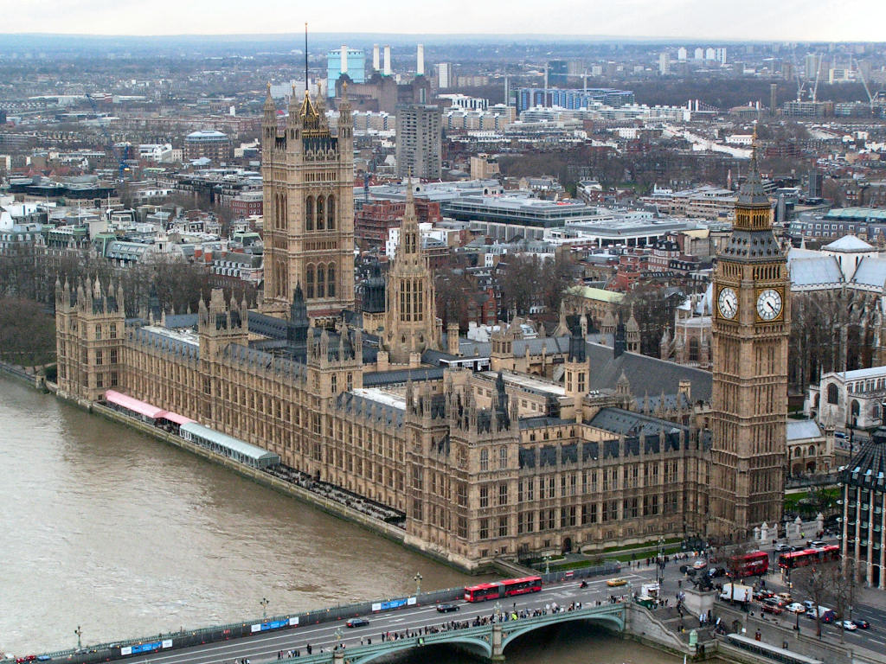
The Palace of Westminster

Slide 4
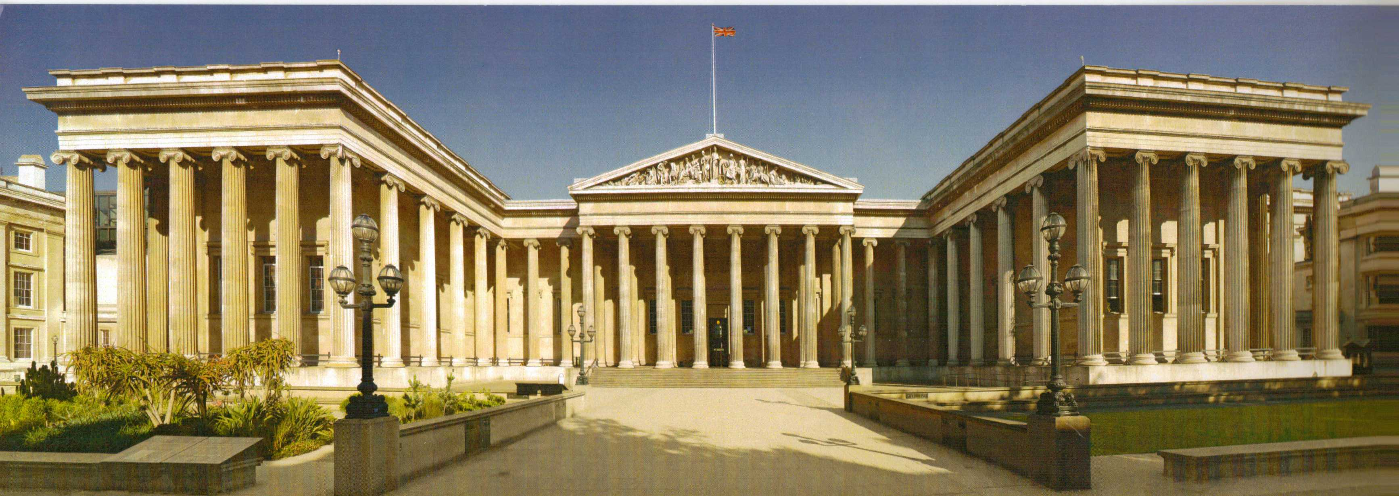
The British Museum

Slide 5
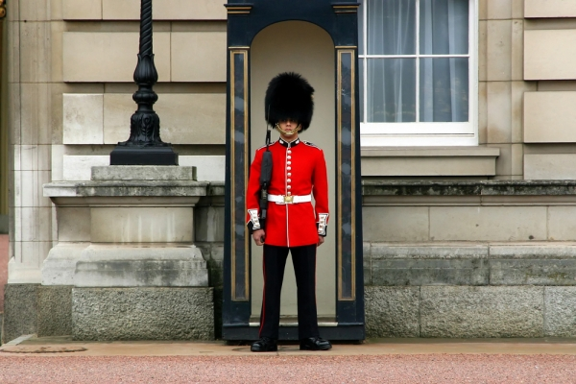
Buckingam Palace

Slide 6
Conclusion - Thanks everybody for listening me.
Sources :
http://www.alternatives-economiques.fr/
http://www.journaldunet.com/economie/finance/places-financieres.shtml
http://www.visitlondon.com/things-to-do/sightseeing/tourist-attraction/big-ben

