Slide 1
Weapons in the 21st century
Michaël Gallego
Bruno Gabriel

Slide 2
What is a weapon ?
It is a tool…
… to apply force for the purpose of hurting or killing someone
Weapons were used throughout the ages
Even chimpanzees use weapons !
But weapons evolved… A LOT !
Notes:
Bruno :
According to Wikipedia, a weapon is a tool used to apply force for the purpose of hurting or killing someone. Weapons were used throughout the ages, and scientists even found very simple weapons among chimpanzees. However, weapons from the Middle Age and weapons from our time are completely different, and like many other fields in our society, weapons largely benefited (and still benefit) of technology advancements. In the first part, we will review some of the new weapons that emerged recently, and then we will focus on the flash-ball, which is a new French weapon mainly used by law enforcement officers.

Slide 3
Why did they evolve ?
World War II was a turning point
The atomic bomb : mankind is now able to kill itself
Like any other fields, weapons benefited (and still benefit) of technology advancements
New weapons also emerged : non-lethal weapons
They answered to new needs
Notes:
MICHAËL :
Like we have said before, weapons have evolved a lot. World War II was a turning point (un tournant), because science really helps the creation of new weapons. The atomic bomb is one of the best example. Since then, we all know that we are able to create weapons that can destroy the World.

Slide 4
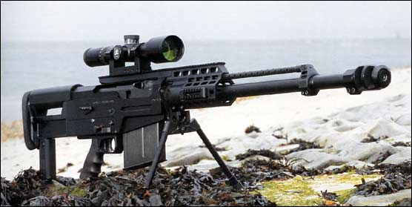
AS50
Released in 2006
Incendiary and explosive bullets
Accurately reach targets at nearly 2 km distance
Notes:
BRUNO :
This weapon is an AS50 and was released in 2006 by Accuracy International. This weapon, for example, really shows how science and weapons meet together. This weapon can use both incendiary and explosive bullets. Furthermore, it can accurately reach targets at nearly two kilometers distance.

Slide 5
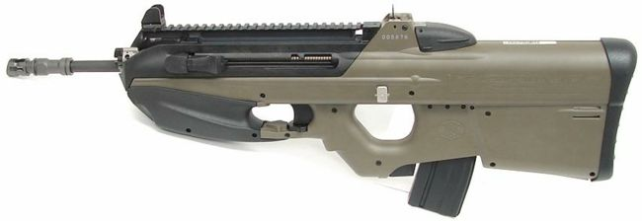
FN FS2000
Released in 2001
Can be hold using one hand
Built-in laser sight, halogen lights, grenade launcher…
Notes:
BRUNO :
This weapon, called the FN FS2000 was developped in 2001 and was thought to be the 21st century weapon. The innovation in this weapon is that it can be hold using only one hand, so soldiers can make something else with their second hand. It has many features like built-in laser sight, halogen lights and even a grenade launcher.

Slide 6
Non-lethal weapons
Also called ironicaly « less-lethal weapons »
Those weapons recently emerged
Used in combat situations to limit the escalation of violence
Scent-based, psychochemical, taser, flash-ball…
Notes:
BRUNO :
But the 21st century also emerged so-called non-lethal weapons, sometimes called "less-lethal weapons", not-so ironically. Those weapons are used in combat situations to limit the escalation of violence, or in some places where policeman are often attacked and can defend themselves without killing people.
Some weapons are quite funny, like the scent-based weapons. One of those weapons is called the Skunk (in reference of the animal - le putois -), and was first used in 2004 in Israel. This weapon produce smells so horrible that people are forced to leave the area.
Psychochemical weapons, or drug weapons, are weapons that are based on chemistry (chimie). Some of those weapons use drugs like LSD in order to disorienting people or during interrogation.
Finally, there is a very famous weapon, because it was created by French people : the flash-ball. The special feature of this weapon is that it uses soft rubber ball. It is mainly used in France by policeman.

Slide 7
Is this dangerous ?
Why non-lethal weapons emerged ?
Illegal market of weapons is more and more widespread
  Having a weapon is really easy nowadays
Violence is increasing : shooting a policeman is no more a problem
They have to defend themselves !
Notes:
MICHAËL :
First of all, we should ask why those non-lethal weapons were created, like flash-ball. We think that the reason is quite simple : the illegal market of weapon is more and more widespread and, although you need a licence to hold weapons, many people bypass this rule. As a consequence, the violence, in particular in suburbs, is increasing, and they don't hesitate now to shoot on policeman. However, the job of a policeman is not to kill all those people, BUT they have to defend themselves in order not to be killed. And here are non-lethal weapons.
Therefore, we think that non-lethal weapons like tazer or flash-ball is something good, but the main problem is that it's not always as non-lethal as they want. In fact, this weapon is not always well-used. First, flash-ball can't be used within 7 meters, and you can't shoot the head. But some studies showed that the precision of the balls is not very high, and therefore it can reach some parts of the body that should not. Furthermore, this weapon can causes irreversible injury or even death if it is used in less than 5 meters. Of course, when there are a lot of people, that comes with panic, it's rather hard to know if you are within 5, 6 or 7 meters.
In France, since 2005, many people suffered from irreversible injury, especially in the eyes.

Slide 8
Thank you !

