Slide 1


Slide 2
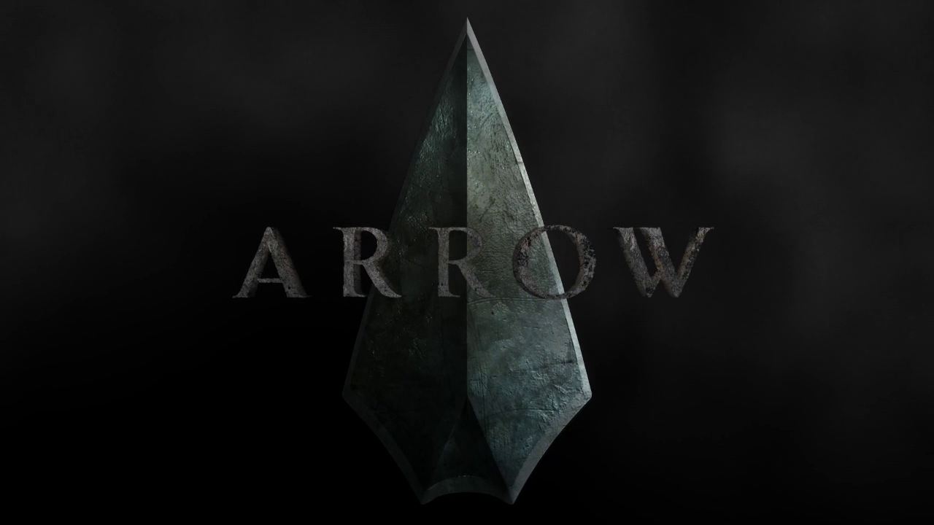
Anh-Toan NGUYEN
Arthur GAUTIER
11/19/2014
L2
Groupe 2
Mrs. MASSON-LEVY

Slide 3
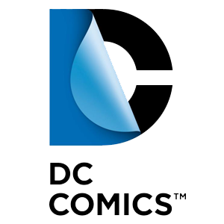
Introduction
DC Comics : created in 1935.
Creator of more than 20 superheroes.
Green Arrow, created by Mort Weisinger and George Papp : 1941.

Slide 4
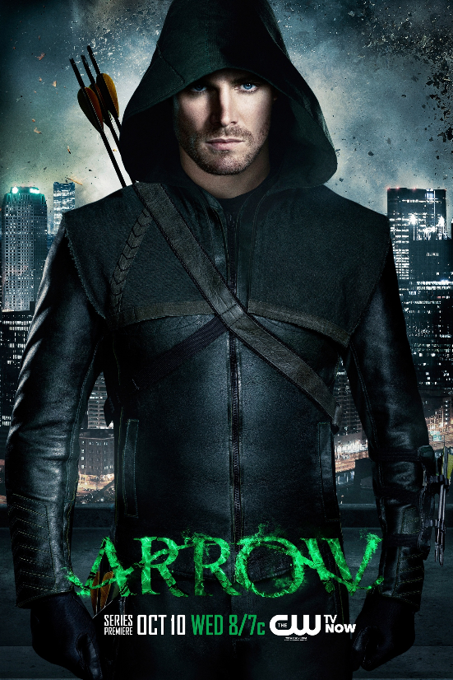
The Broadcast
Broadcasted since October 2012 in the USA (The CW).
53 episodes, 54th is tonight.
Pilot episode : 4.14 million viewers in the USA.
First season : 3.68 million viewers (in the USA).
Mainly shot in Vancouver (British Columbia, Canada).
Favorite new series award by TV Guide (2013).
2nd place best TV hero for Stephen Amell (IGN Awards, 2014).

Slide 5
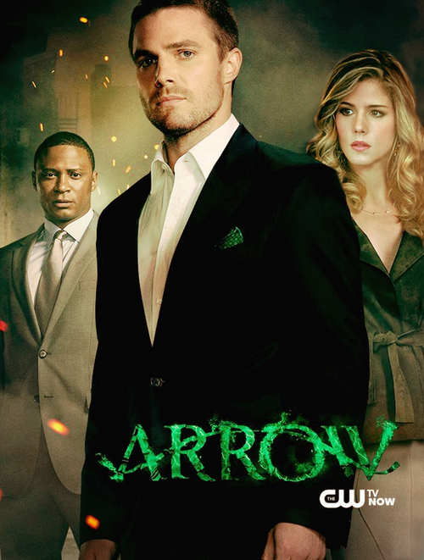
The Plot
Stephen Amell: Oliver Queen
David Ramsey : John Diggle
Emily Bett Rickards : Felicity Smoak
Story
After a violent shipwreck, billionaire Oliver Queen was presumed dead. He was finally discovered on an island in the Pacific. When he returns home, his family and his friend welcome him but they can feel he has changed. While he hides the truth about the man has become, Oliver creates the secret character of Green Arrow to right the wrongs of his family fight against the evils of society, and restore Starling City to its former glory. To keep his secret identity, Oliver plays the role of a rich womanizer, carefree and neglecting. However, Laurel's father, Inspector Quentin Lance, is determined to stop the vigilante in his city.

Slide 6
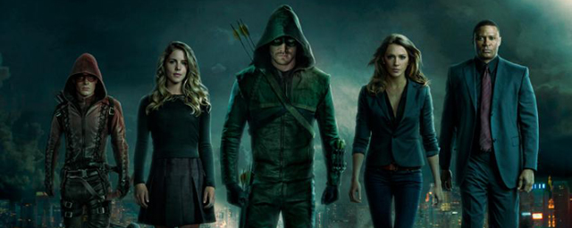
Conclusion
Why do we like these show ?
DC Comics launched a new TV show on 2014 fall : The Flash. Crossovers are already planned for those shows.

