Slide 1


Slide 2
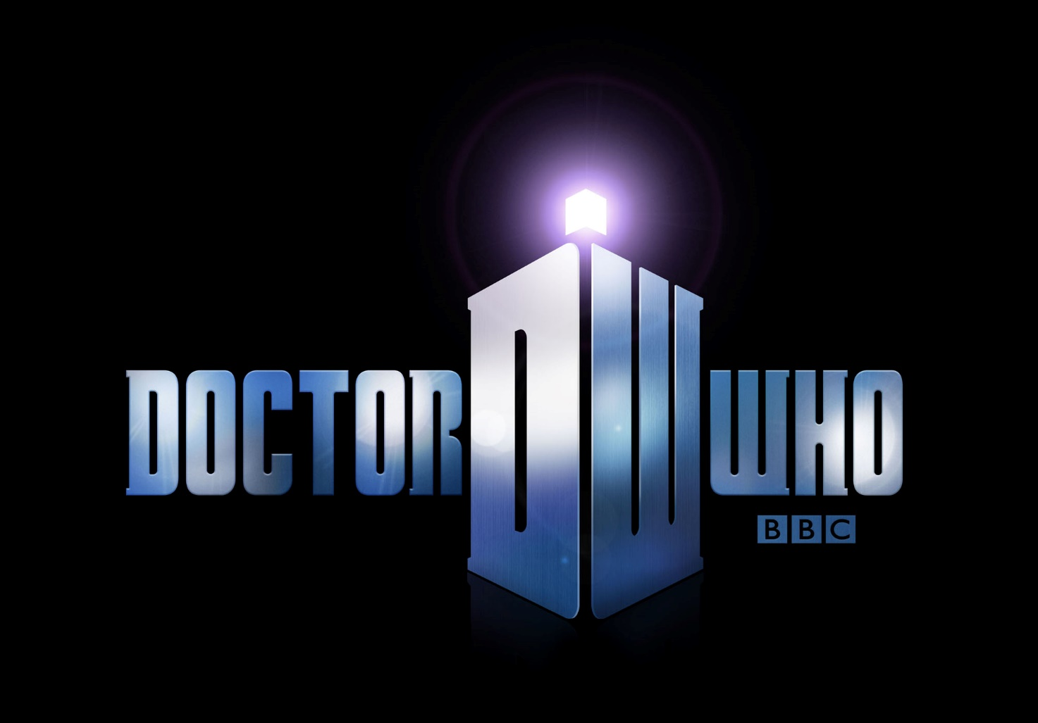
Cedrick OVERZEE
Arthur GAUTIER
27/05/2015
L2
Groupe 2
Mrs. MASSON-LEVY

Slide 3

Introduction
TV show started in 1963 on BBC.
The oldest sci-fi tv show with 813 episodes (26 + 8 seasons) and still more coming up.
Few spin-offs : Torchwood (2006 – 11), The Sarah Jane Adventures (2007 – 11).

Slide 4
The Show
Rebooted in 2005 by Russel T Davies.
Around 8 millions viewers accross the world.
Each season : 13 episodes of 45 minutes + the Christmas episode (~65 minutes).

Slide 5

The Plot
Doctor Who follows the adventure of the Doctor, a Time Lord from Gallifrey, in his travels through time and space. Rarely alone, he has some companions to be with him and see the universe. As a Time Lord, the Doctor has the ability to regenerate when his body is mortally wounded.

Slide 6
The Doctor
Main character of the show.
Up to the ability of regeneration of a Time Lord, a lot of actors are able to be the Doctor (at least 13 were).
He’s now over 2000 years old.

Slide 7
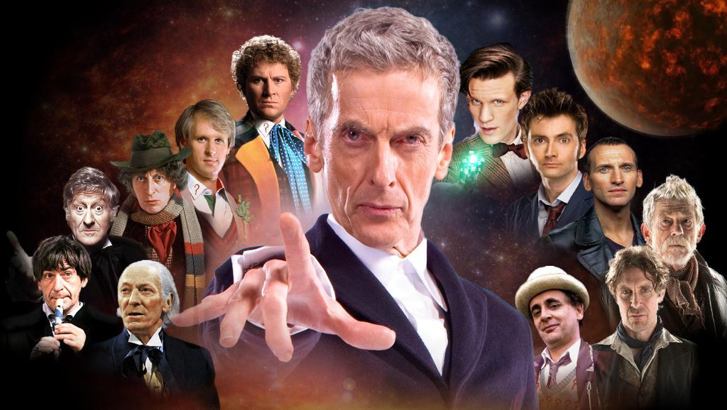

Slide 8
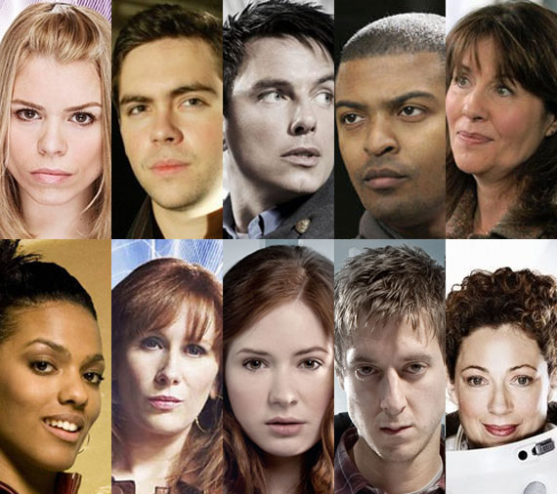
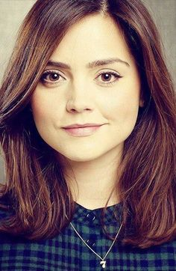
The Companions

Slide 9
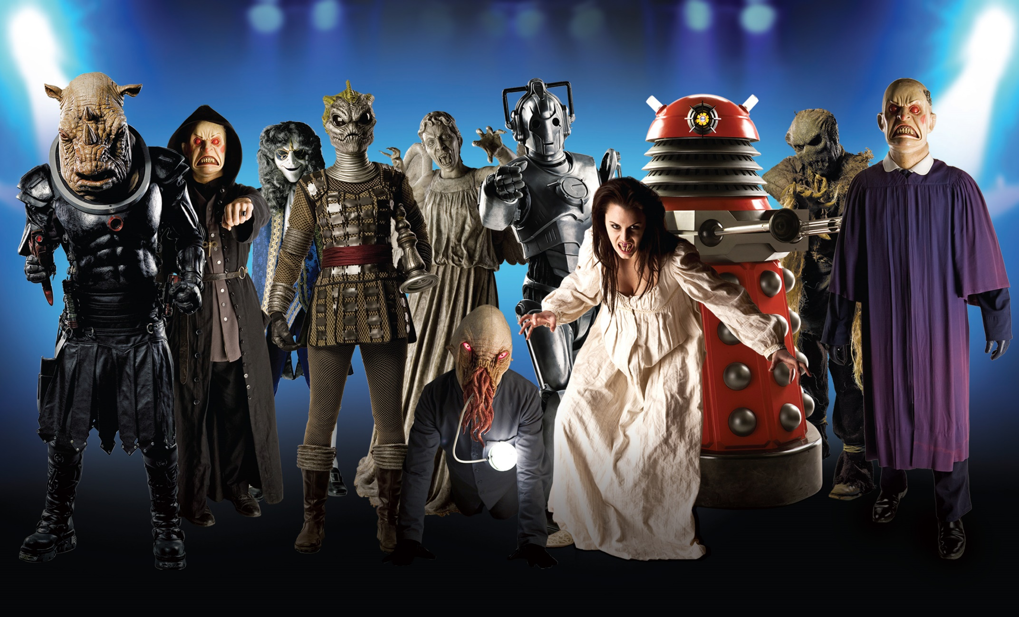
The Enemies

Slide 10
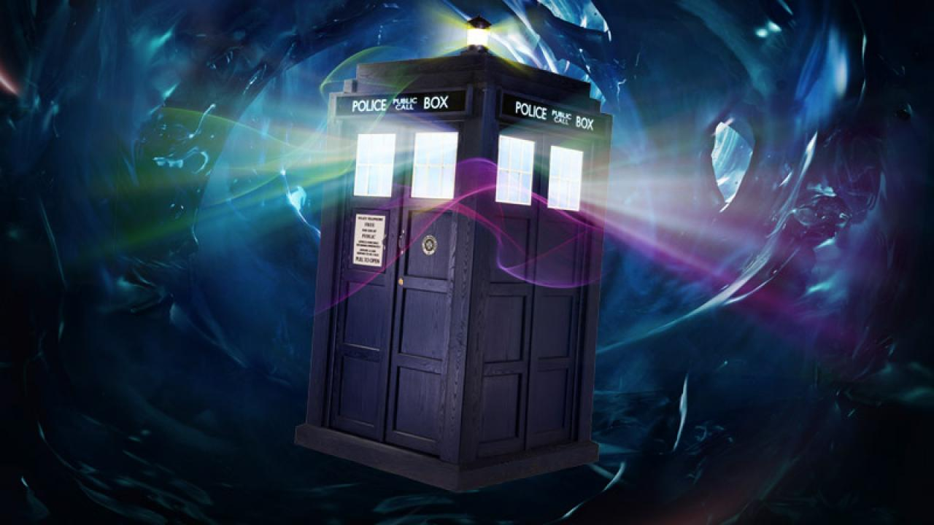
The Tardis
Time And Relative Dimension In Space.
It’s bigger on the inside.
Designed to be piloted by 6 people, the Doctor do it alone.

Slide 11
Conclusion
Why do we loooove this show ?
Next season coming up in fall 2015, you have still time to catch up !
"We’re all stories, in the end… just make it a good one, eh?”
Matt Smith, Eleventh Doctor

