Slide 1
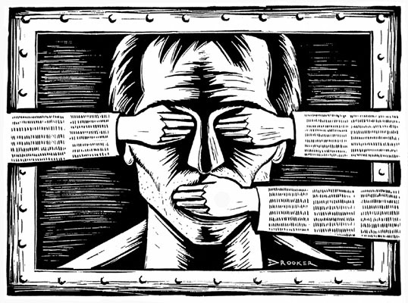

CENSORSHIPS IN CHINA
CHAZAL Baptiste
TARQUINI Adrien
Group 4

Slide 2



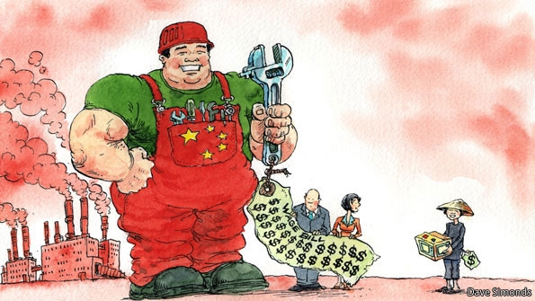
Introduction
20 years Big and steady growth
330 First censorship law
The world’s workshop

Slide 3
I. How the government of china controls the internet
The minister of industry and information technology
State Council Information Office State Internet Information Office
The minister of Public Security
Cyber police

Slide 4
3 softwares to control the internet:
Blue Shield
The Great Firewall of China
Search engines

Slide 5
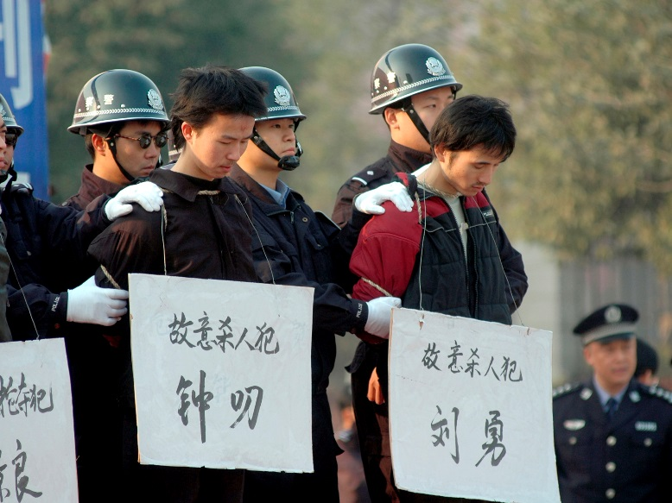
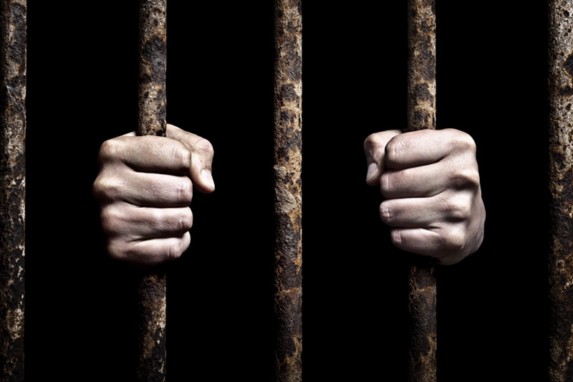
The penalties
Cyber-dissident severely punished
  Fines
  Incarceration
  Death Penalties
World’s record 72%
Well-known case
  Lin Hai
  Wang Youcai
  Huang Qi

Slide 6
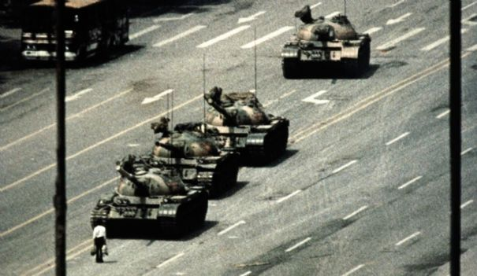
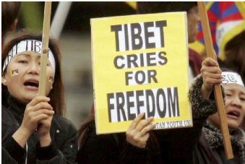
II. Why does China censors the internet ?
Students' demonstrations between April and May 1989
Independence of Tibet

Slide 7

Censored Topics
Keywords
2009 236 words
        18 obscenities
        92% politics
Sites banned
Hidden, blocked, destructed

Slide 8
Conclusion

