Slide 1


Online Dating
CHAZAL Baptiste
TARQUINI Adrien
L2 – Group 4

Slide 2
Summary
1 – What is online dating ?
2 – Risks and security
3 – Some online dating applications

Slide 3
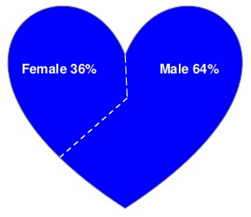
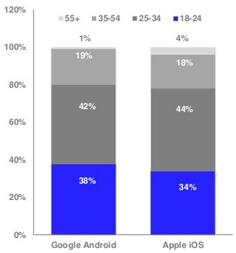
What is online dating ?
Online dating system
Causes for online dating
Some statistics about online dating

Slide 4
Risks and security
Risks
Security
Easy to be fooled
Wasting time
Bad behaviour
Services with subscription are safer
Stop commucation with suspicious people
Always meet in a public place

Slide 5







Some online dating applications

Slide 6
Conclusion

