Slide 1

English Presentation
Alexis Yvin
Alexandre Southakakoumal
L3 group 3
CNP and the financial crisis

Slide 2


To begin…
Alexis Yvin
Alexandre Southakakoumal
L3 Group 3

Slide 3
What is CNP ?
Alexis Yvin
Alexandre Southakakoumal
L3 Group 3

Slide 4
What is CNP ?
France's leading personal insurance company since 1991
Insure 22 million of people
Owned by 4 major shareholders
Involved in three main segments of the personal insurance market:
  Savings
  Pensions
  Personal risk
Alexis Yvin
Alexandre Southakakoumal
L3 Group 3

Slide 5
How did it cope with
the crisis of 2007 ?
Alexis Yvin
Alexandre Southakakoumal
L3 Group 3

Slide 6
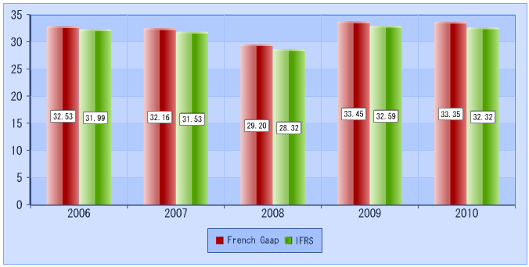
How did it pass the crisis ?
Sales for the last past years (in billions euros)
Today, the CNP’s sales is about 32, 3 billions euros
Sources: cnp.fr
Alexis Yvin
Alexandre Southakakoumal
L3 Group 3

Slide 7
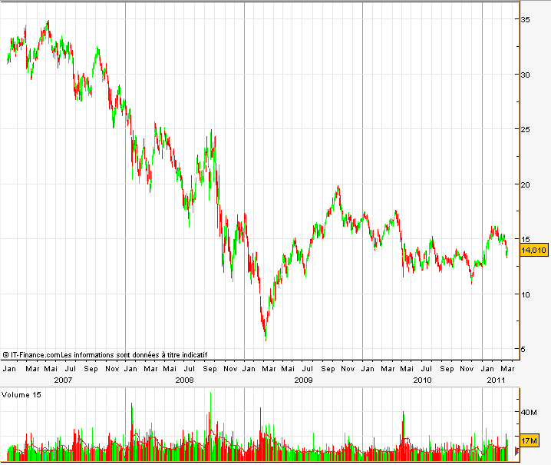
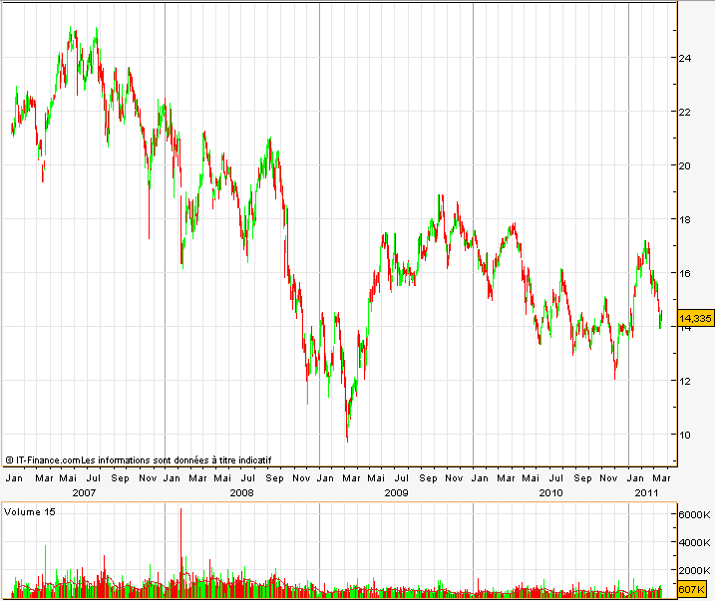
How did it pass the crisis ?
Market trends in stock exchanges for the last past years
AXA Insurance
CNP Insurance
Alexis Yvin
Alexandre Southakakoumal
Sources: Daily-bourse.fr
L3 Group 3

Slide 8
How did it pass the crisis ?
Market share of insurances for the last past years
2007
2011
Alexis Yvin
Alexandre Southakakoumal
Sources: cnp.fr
L3 Group 3

Slide 9
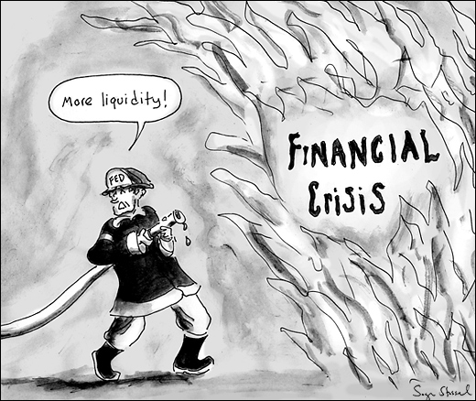
Finally…
Alexis Yvin
Alexandre Southakakoumal
L3 Group 3

Slide 10
Thank you for your attention
Alexis Yvin
Alexandre Southakakoumal
L3 Group 3

