Slide 1

Investors pull $7bn from emerging funds
An article from Financial Times By Barney Jopson and Nicole Bullock on February 4th

Slide 2

Summary
The biggest withdrawal for 3years in the emerging funds
  Unease to predict the evolution of some big emerging countries
  Egyptian revolution
  Turmoil in middle east and food
  inflation

Slide 3

Summary
This benefits to developed countries with the 5th week of increasing inflow
Are investors rotating out of emerging into developed market equities?
rotating out of emerging into
developed market equities

Slide 4
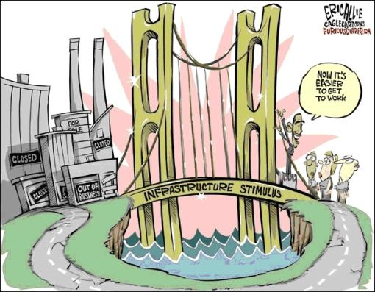
Conclusion
Markets are trying to avoid same errors as in the past
Emerging country scares investors
Is this movement only due
to the situation in Egypt
and Tunisia?

Slide 5
Thanks for your attention

