Slide 1
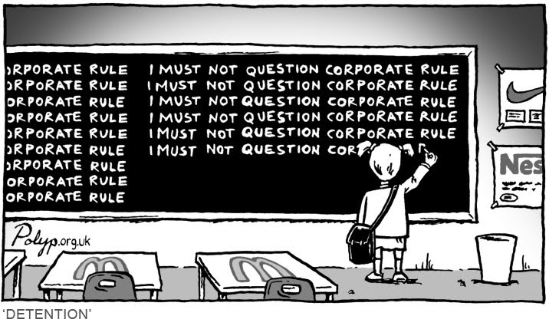
Privatization of education
in France

Slide 2
The cost
High schools are very expensive
  22,500€ for the inscription
Increase the social gap
Flow of emigration to reach cheap schools

Slide 3
The cost
Flow of immigration of rich students
Reduce taxes
Better supervision of the students
Companies can invest to reduce the cost

Slide 4
The quality of the education
France has already a good level
  France has more people with BAC than US
Studies help to climb the social ladder
Is the level the same when we want earn money
  Education is an estimated market of 50billions €

Slide 5
The quality of education
Higher level of the education
  Lots of invests from the benefits
Better formation for a future job
  Communication with companies
  Less unemployment
More different formations by its modularity

Slide 6
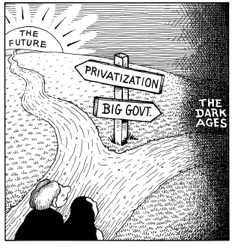
Money for future or stability with government?

Slide 7

How much to be graduate?

