Slide 1


Business plan
Franck ACHKOUYAN – Nicolas HUBERT Antonin LAPICHE – Hugo SCHOUMAN
Mr TEOH
Group N°8

Slide 2
Table of Content
Executive summary
  The company
  The market
  Financial
Industry analysis
Products and Services
  Products
  Services
Marketing plan
  Market segmentation
  Target market segment strategy
  Channels of marketing

Slide 3
Table of Content
Strategy and implementation summary
  Sales strategy
  Milestones
Human Resource plan
  Employees
  Salaries
Financial plan
  Break-even analysis
  Pro forma income statements
  Pro forma cash flow
  Start up fundings

Slide 4
Executive Summary
The company name: Business Box
SME : 8 employees
The location: Kuala Lumpur, Malaysia
Financial:
  Minimal credit: $500,000,
  Reality: only need $300,000 credit

Slide 5
Objectives
Main
objectives
Increase our visibility
Achieve a net profit superior of $50,000 by the end of 2010

Slide 6

Industry Analysis
Competitors in this market :
  Similar gift basket type retail stores
  Fruits
  Flowers
  Toys
Seasonal business
  Corporate market
  Working all the year

Slide 7
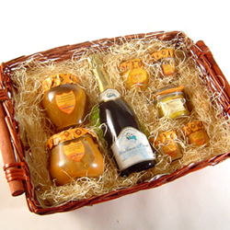
Products and Services
Standard packages
Custom packages
Uniqueness
Good quality
Meeting the deadlines

Slide 8
Market segmentation
Two distinct market segment :
  Individuals (10%)
  Corporates (90%)
Growth of individuals segment, up to ≈ 30%
Year | 1 | 2 | 3 | 4
Corporates | 90 | 85 | 78 | 70
Individuals | 10 | 15 | 22 | 30

Slide 9
Target market segment strategy
Two segment complementary
  Securize the market
  Less seasonal
Our strategy is focused on corporates (90%)
  Demand stay constant all the year
  Target likes luxury image

Slide 10
Channels of marketing
Luxury, good quality product with very good reputation
Welcoming shop
Website with good position in Google (investissement in AdWords)
Tasting presentation in companies
Articles in luxury magazines
Word of mouth

Slide 11
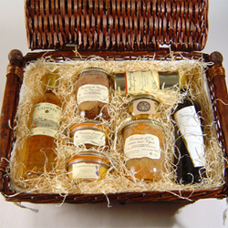
Sales strategy
Being unique with smart design and quality product
Do not make huge advertisement campaigns
Improving a small quantity of products
  Target: middle and high social classes

Slide 12
Milestones
Milestone | Start Date | End Date | Budget | Manager | Department
1. Make sure the business plan will be followed as a road map for the company. | 01/01/2010 | 31/02/2010 | $ - | CEO | Executive board
2. Find and buy a warehouse. Then set it up. | 01/01/2010 | 07/01/2010 | $ 220 650,00 | CEO | Executive board
3. Find and rent a POS. Then set it up. | 01/01/2010 | 14/01/2010 | $ 4 000,00 | CEO | Executive board
4. Hire and train new employees. | 07/01/2010 | 31/01/2010 | $ 200,00 | CEO | Executive board
5. Production of brochure and website. | 01/02/2010 | 14/02/2010 | $ 4100,00 | Employees | Marketing
6. Sell at least 200 baskets/boxes. | 01/03/2010 | 31/03/2010 | $ - | Salesmen | Sales
Total |  |  | $ 234 950,00

Slide 13
Human resource plan
Salesman (By preference 1 man & 1 woman)
Answer the phone and take order
Manage the shop
Receive the basket from the warehouse and transmit to customers
Stock manager
Manage the raw materials and provide it to the manufacturers
Custom manager
Take care of the specialized orders
Purchasing manager
Find and buy raw materials
Discover new opportunities
Manufacturers (2 people)
Prepare the baskets
Deliver baskets to the shop
Commercial agent
Visit companies from corporate market
Organize tasting events
Salesmen | $ 1 800,00
Stock manager | $ 1 400,00
Custom manager | $ 1 700,00
Purchasing manager | $ 2 000,00
Manufacturers | $ 1 400,00
Commercial agent | $ 1 800,00

Slide 14
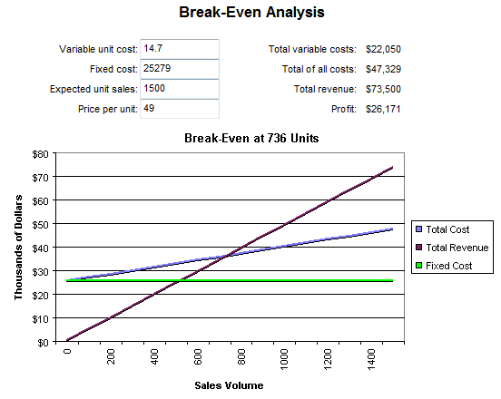
Break even analysis
Break even:
  Average price 49$
  Average profit : 70 %
  Average monthly fixed cost of our business : $25279
  Green line : fixed cost
  Blue : Product price
  Red : profit
  Circle : Break even

Slide 15
Pro forma income statements
In USD $ | Jan | Feb | Mar | Apr | May | June | July | Aug | Sept | Oct | Nov | Dec | Jan | Feb | Totals
Sales | 0 | 0 | 7350 | 22050 | 36750 | 39200 | 41650 | 44100 | 58800 | 53900 | 68600 | 88200 | 88200 | 83300 | 632100
less Cost of goods sold | 0 | 0 | 2205 | 6615 | 11025 | 11760 | 12495 | 13230 | 17640 | 16170 | 20580 | 26460 | 26460 | 24990 | 189630
Gross profit | 0 | 0 | 5145 | 15435 | 25725 | 27440 | 29155 | 30870 | 41160 | 37730 | 48020 | 61740 | 61740 | 58310 | 442470
Operating expenses
Salaries | 0 | 12900 | 12900 | 12900 | 12900 | 12900 | 12900 | 12900 | 14700 | 14700 | 16100 | 16100 | 16100 | 16100 | 184100
Rent | 0 | 4000 | 4000 | 4000 | 4000 | 4000 | 4000 | 4000 | 4000 | 4000 | 4000 | 4000 | 4000 | 4000 | 52000
Utilities | 150 | 150 | 150 | 150 | 150 | 150 | 150 | 150 | 150 | 150 | 150 | 150 | 150 | 150 | 2100
Advertising | 13600 | 5000 | 5000 | 5000 | 600 | 600 | 600 | 2000 | 5000 | 600 | 5000 | 5000 | 5000 | 5000 | 58000
Selling expenses | 500 | 500 | 500 | 500 | 500 | 500 | 500 | 500 | 500 | 500 | 500 | 500 | 500 | 500 | 7000
Payroll taxes | 0 | 1290 | 1290 | 1290 | 1290 | 1290 | 1290 | 1290 | 1470 | 1470 | 1610 | 1610 | 1610 | 1610 | 18410
Depreciation | 600 | 600 | 600 | 600 | 600 | 600 | 600 | 600 | 600 | 600 | 600 | 600 | 600 | 600 | 8400
Office expenses | 14150 | 750 | 750 | 750 | 750 | 750 | 750 | 750 | 750 | 750 | 750 | 750 | 750 | 750 | 23900
Total operating expenses | 29000 | 25190 | 25190 | 25190 | 20790 | 20790 | 20790 | 22190 | 27170 | 22770 | 28710 | 28710 | 28710 | 28710 | 353910
Gross profit | -29000 | -25190 | -20045 | -9755 | 4935 | 6650 | 8365 | 8680 | 13990 | 14960 | 19310 | 33030 | 33030 | 29600 | 88560

Slide 16
Pro forma income statements

Slide 17
Pro forma cash flow

Slide 18

Start up fundings
Start up expense statement for the 1 Month ending Jan. 31, 2010.

Slide 19
Thank You !

