Slide 1

The future of drinks: W&H

Slide 2


The situation

Slide 3

Malaysia
28 millions inhabitants
68% between 15 and 65 years old
No predominant religion
Around 19,4 millions potential buyers

Slide 4

The market
Market is increasing
Highly profitable market
1st drink market before carbonated drinks and alcohols

Slide 5
The venture
4 partners with completing backgrounds
A revolutionary product
A start from nothing
A new brand with the best image:
  Green & sustainable development
  Modern
  Dynamic
  Healthy

Slide 6

Industry analysis

Slide 7
Industry analysis
Fast growing market: 5.7% per year !
2.5 billion RM per year !
15-64 years old in Malasia : 68 %

Slide 8
Industry analysis
Non-carbonated drinks : +5.4%
Carbonated drinks : -3.2%

Slide 9
Industry analysis
Tea consumption in Malaysia: 0.5kg/year
Much higher than in other countries…
… because Malay want to be healthy !

Slide 10
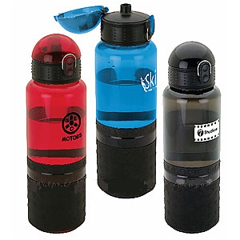
Description of the product

Slide 11
History of the product
An old success
Originally from Europe
Actualized for modern times

Slide 12
Company plans
A partnership managed by a council of 4
December: Drop off brevets
January: Start the build of the manufactory and develop a distribution network
October: beginning of the advertising
November: product launching

Slide 13
Research and development
Constant survey to evaluate the products
  Free feedbacks on Internet
  Official survey every 5 years
A laboratory for increasing artificial flavors
Development of new flavors and/or products

Slide 14

Operational and production plan

Slide 15
Operational and production plan in figures
Target: 24000 bottles/day
  ½L: 12000
  1L: 12000
2 production chains
5 different flavors
➔ 4800 bottles of each flavor
R&D department
Delivery department

Slide 16
The control of operational and production
Daily quality control
Continuous control of the production chains
  2 employees per chain
  1 responsible to supervise per chain
1 trimestral audit

Slide 17



Current target market
Notes:
Our new product is targeted to the mass market, without religion distinction. The main innovation of this product is its green and healthy images. It is therefore aimed at both well-off people and poorer people: this non-carbonated drink’s goal is to have a new way to consume drinks.

Slide 18
Current target market
MASS MARKET
Notes:
Pareil que le précédent.

Slide 19

Current target market
People want to be green
Notes:
Customers should perceive our product as being different, and associate our brand, W&H (Water & Health), with a green and healthy image. This is the key to differentiate us from our competitors: both Coca-Cola and F&N have products that have a bad image, whereas our company only has healthy products. Green business is really booming in Malaysia [1].

Slide 20
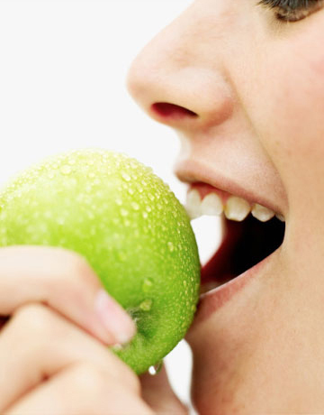
Current target market
People want to be healthy
Notes:
Pareil que le précédent.

Slide 21

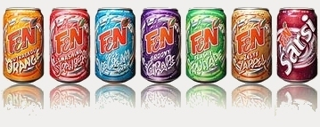

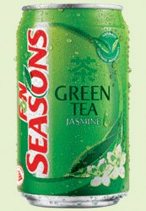
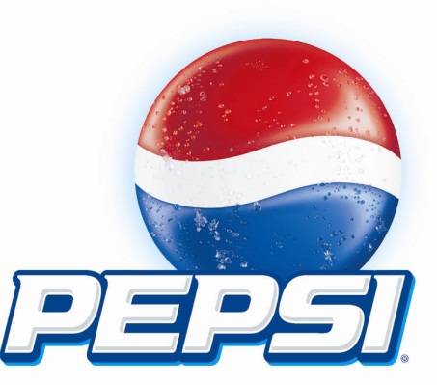
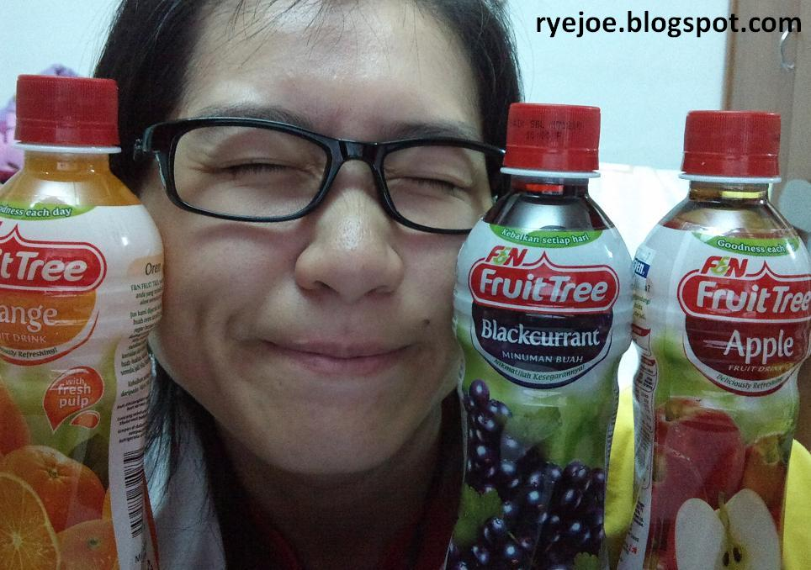
Current competitors
Notes:
We expect to have a strong reaction from our competitors that would launch new products similar to ours.
We will focus on only one line of products: the non-carbonated drinks. This will make our products easier to identify and link to the company. Consumers will not be lost with a lot of different products, which is important from a marketing point of view, because we can focus on those products only. We expect the products to be bought by everyone: from the parent purchasing for children, to young adults that want to take care of their health while still drinking something different from pure water.

Slide 22
Current competitors
WE STAY FOCUS ON ONLY ONE INNOVATIVE PRODUCT

Slide 23
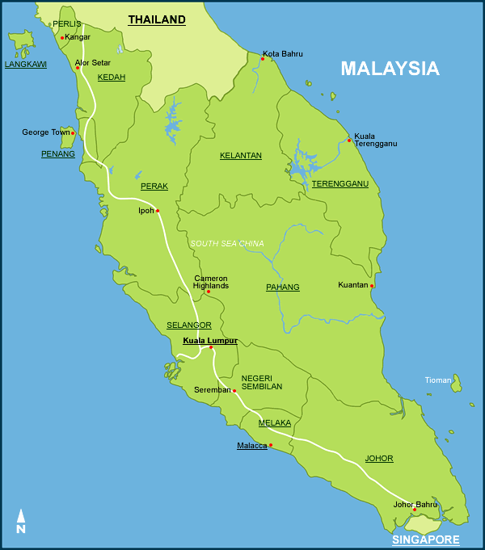
Current distributor network
Notes:
Having an efficient distributor network is an important part of the marketing plan. Our goal is to focus on the west coast of the country first. Our product has to be sold in every sales outlet, from big supermarkets like Giant to smaller one like 7-Eleven. It should also be sold by Internet.

Slide 24

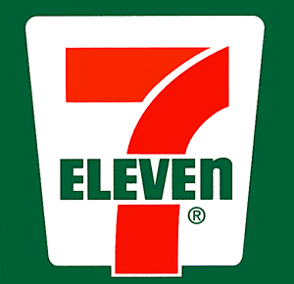
Current distributor network
Notes:
We believe that our product should not be positioned along traditional soft drinks, but next to mineral water and/or fruit juice, still to enforce the healthy image.

Slide 25
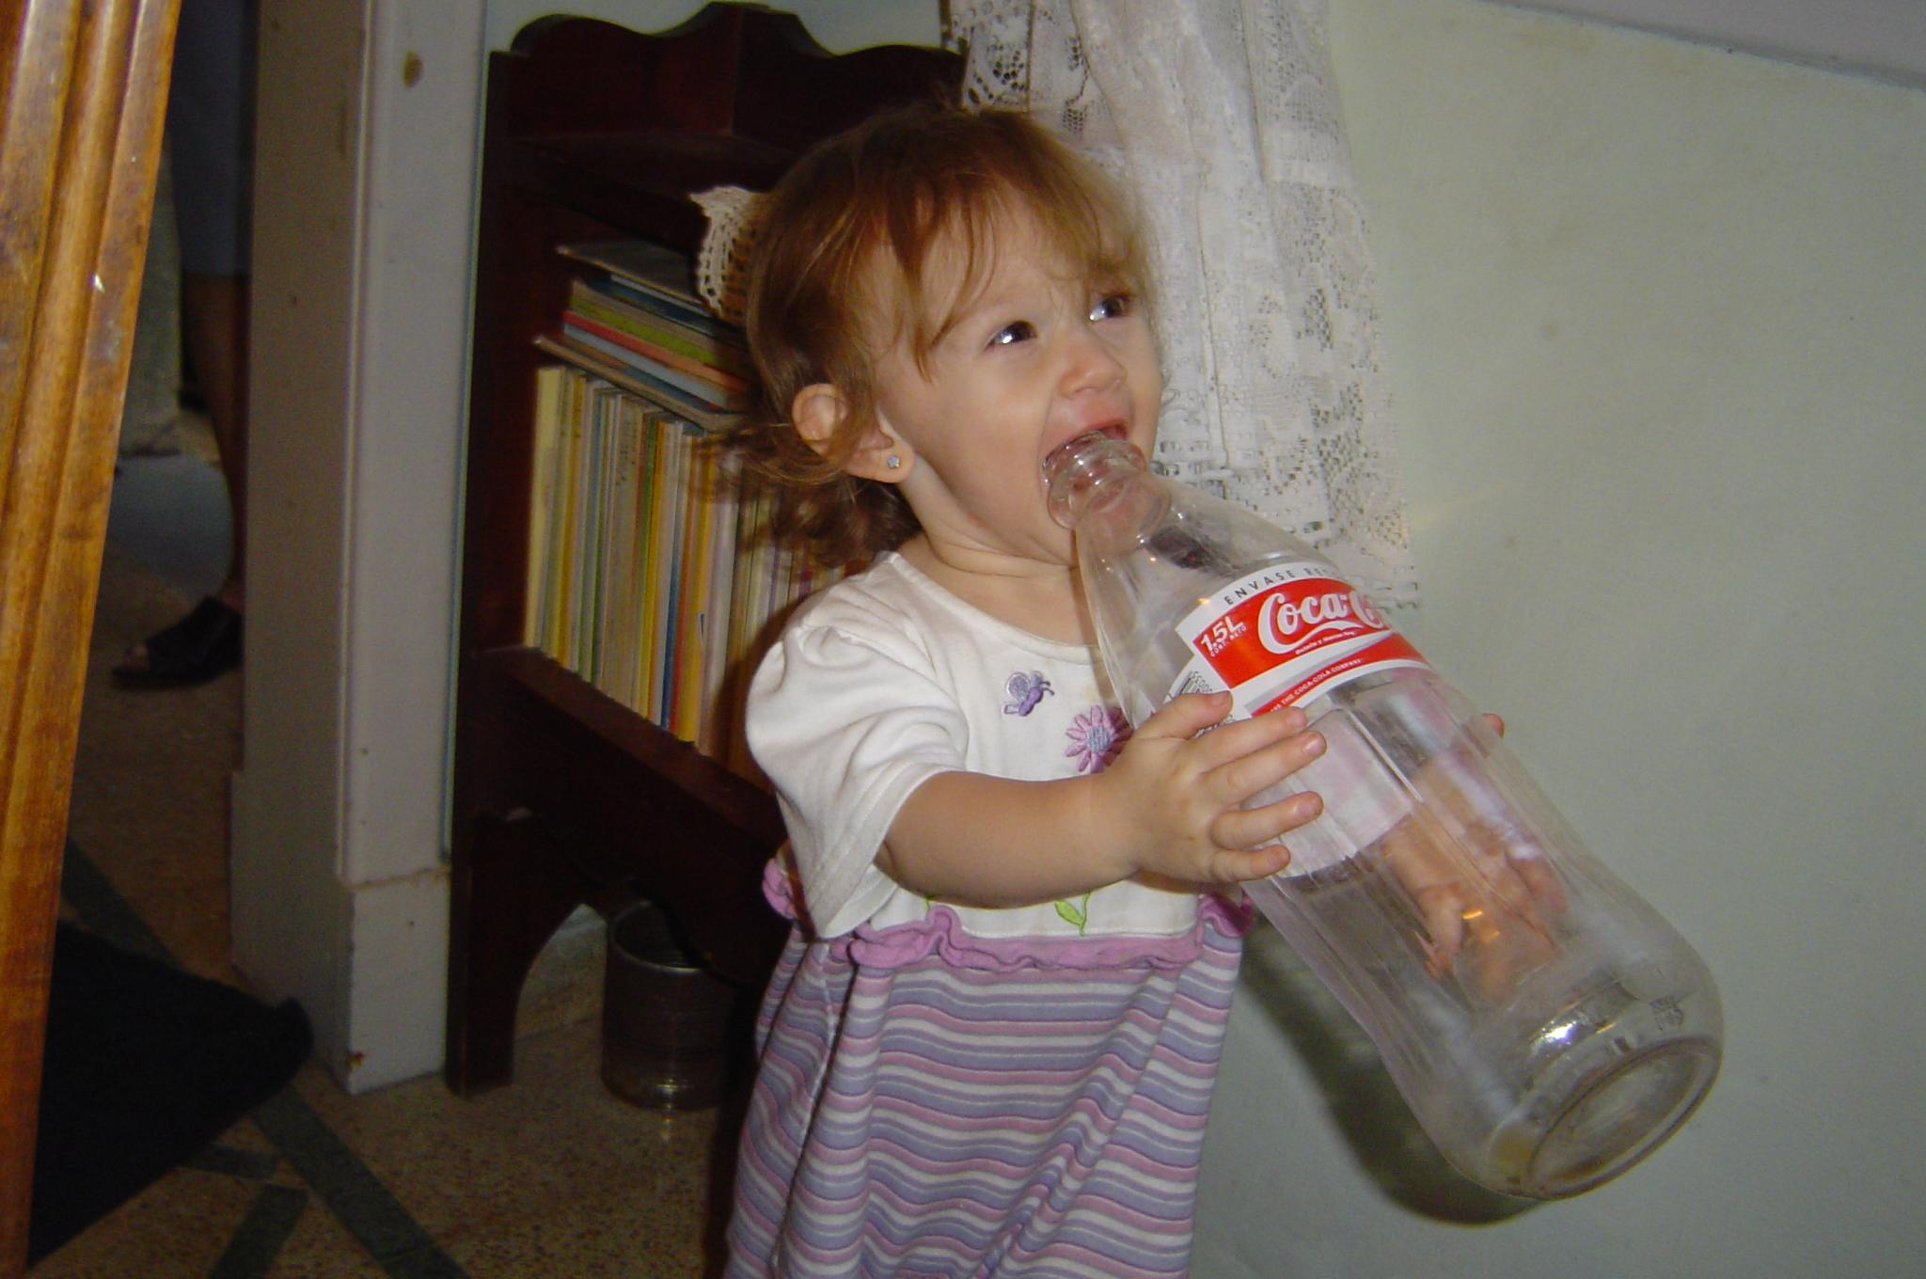
Current distributor network
Notes:
We believe that our product should not be positioned along traditional soft drinks, but next to mineral water and/or fruit juice, still to enforce the healthy image.

Slide 26
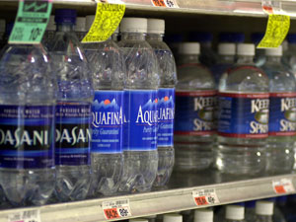
Current distributor network
Notes:
We believe that our product should not be positioned along traditional soft drinks, but next to mineral water and/or fruit juice, still to enforce the healthy image.

Slide 27
Product
The name have to be: simple, while still recall the concept

Slide 28
Product
Wat’Orange
Wat’Apple
Wat’Pinneaple

Slide 29
Product
Transparent packaging
« Green » colors
Simple label
Notes:
The packaging will feature a transparent bottle, so that consumers can see clearly that it looks like water. The label stick to the bottle should clearly indicate the taste, and remind the “healthy” and “green” by using appropriate colors (green, blue…).

Slide 30
Promotion
New product, be clever

Slide 31
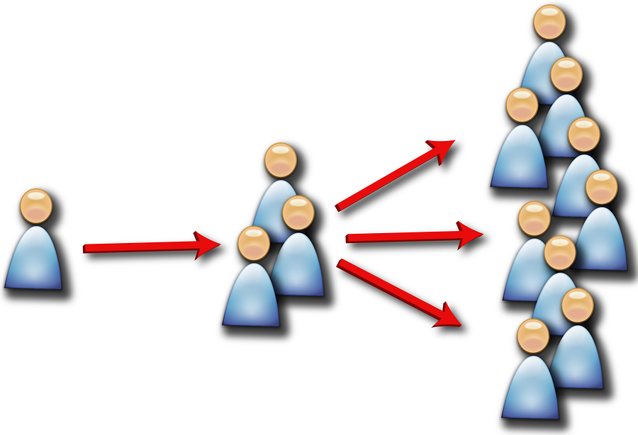
Promotion
Notes:
First of all, the use of Internet is important. Creating a modern website for presenting our product is cheap and can have a big impact on sales. Focus must be made on the healthy and green part. Explicit figures (for example, quantity of sugar) must compare our product to other non-carbonated drinks, so that it shows clearly the benefits of our drink.
We can also think of a contest on the Internet. This can lead to “viral marketing”. For example, we can ask people to create the most original video with our new non-carbonated drink, and put them on share web services like YouTube or Dailymotion. This is nearly-free advertising and can have a huge impact on sales.

Slide 32
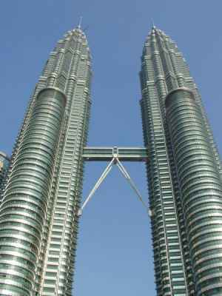
Promotion
Notes:
As we have said before, our company will focus first on the western part of the country. To introduce the product to everyone, several bottles will be given for free at specific points of biggest cities. For example, in Petronas Towers and Pavilion in Kuala Lumpur, because those places are already crowded, and it is quite easy to introduce it.

Slide 33

Human resource plan

Slide 34
Human resource: employees
Production chain workers
Supervision team
Scientists
Maintenance team
Drivers
Audit committee

Slide 35
Human Resource: managers
Finance & accounting
Sales & marketing
Operational
Supply chain & logistic
Quality

Slide 36
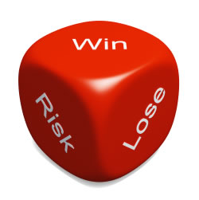
Assessment of risks

Slide 37

Market risks
New in the market
Competition
Slow adoption

Slide 38
Operational risks
Internal/External Fraud
Employment practice (ex : discrimination)
Business practice (ex : market manipulation)

Slide 39
Operational risks
Damages to physical assets
Business disruption and system failure
Execution, delivery and process management

Slide 40
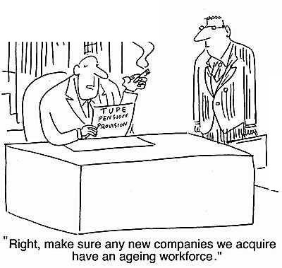
Staffing risks
Union
Skilled workforce

Slide 41

Financing risks
Liabilities
Investors
Litigation

Slide 42

Managerial risks
Keep investors
Active board

Slide 43

Financial plan

Slide 44
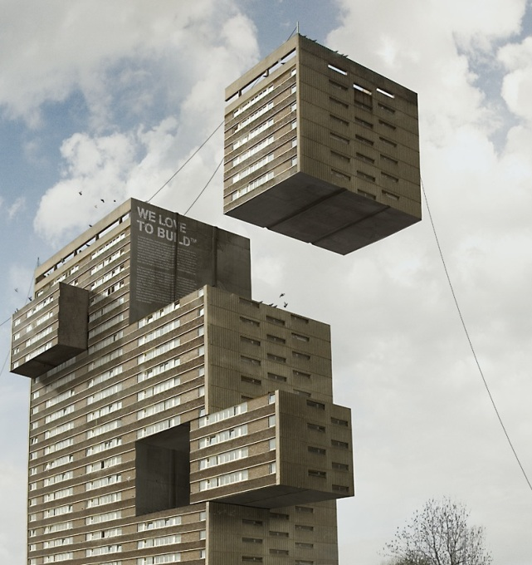
Start up expenses
Business registration fees
License and permits
Inventory
Down payments

Slide 45

Operating expenses
Salaries
Raw materials
Promotion
Distribution

Slide 46
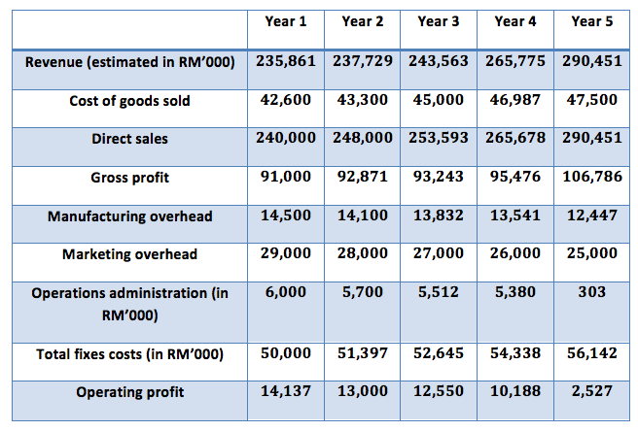
Previsions

Slide 47

Business plan

