Slide 1
20090928
EFREI BM057

Slide 2
EFREI BM057 Individual Written Class Assignment
Hand out date: 14 Sept 2009
Hand in date: 28 Sept 2009

Slide 3
Submission date: Monday 28 September 2009
Format of submission: Type written
Email: lecturing@gmail.com or
eximmalaysia@gmail.com
Word count: approx.1,000 words excluding list of references, tables and charts

Slide 4
Topics
Entrepreneurship CAN be taught. Discuss
[Class Attendance list No. 1 to 10]
Entrepreneurship CANNOT be taught. Discuss
[Class Attendance list No. 11 to 20]
Entrepreneurs are BORN not MADE. Discuss
[Class Attendance list No. 21 to 30]
Entrepreneurs are MADE not BORN. Discuss
[Class Attendance list No. 31 to 41]

Slide 5
Review of study visit to night retailers on 24 Sept 2009
Black economy, or grey economy
1:3
Lawn cutter
Cleaners
Food retailers

Slide 6
In Malaysia
Entrepreneurs to the Malaysian economy

Slide 7
SME’s contribution to the Malaysian economy
They contribute 32% to the country’s GDP and employ 56% of the country’s workforce (excluding the Government). Furthermore, they make up nearly 20% of Malaysia’s total exports.

Slide 8
Malaysian’s Manufacturing SME in 2010
GDP contribution to increase from 32% in 2005 to 37% with the bulk of the growth targeted to come from the services sector, making up 23% of GDP by 2010
Employment (excluding Government) to increase from 56% in 2005 to 57% of total employment
Exports from 19% to 22%, with SMEs in the manufacturing sector contributing to 12% of the total exports.

Slide 9
Malaysia’s Objective for SME
National SME Development Council, chaired by Prime Minister has set a 2-3-4 objective for SMEs:
at least half 1/2 of GDP
A third1/3 of employment
And fourth 4th of export.

Slide 10
Malaysia’s definition of SME
SMEs – Small and Medium Enterprises
Approved on 9 June 2005, the National SME Development Council [NSDC]
Applied across economic sectors and adopted by all Government Ministries, their agencies as well as financial institutions.
Source: National SME Development Council Secretariat
[To be transferred from BNM to SME Corp – SMIDEC
on 2 Jan 2009]

Slide 11
Malaysia’s definition of SME
SMEs – Small and Medium Enterprises
Approved on 9 June 2005, the National SME Development Council [NSDC]
Applied across economic sectors and adopted by all Government Ministries, their agencies as well as financial institutions.
Source: National SME Development Council Secretariat
[To be transferred from BNM to SME Corp – SMIDEC
on 2 Jan 2009]

Slide 12
Definition of SMEs - Based on number of f/t employees
Size & Sector | Mftg incldg agro-based & MRS* | Primary Agriculture | Services Sector incldg ICT**
Micro SMEs | 1 to 5 | 1 to 5 | 1 to 5
Small SMEs | 5 to 50 | 5 to 19 | 5 to 19
Medium SMEs | 51 to 150 | 20 to 50 | 20 to 50

Slide 13
Definition of SMEs - based on annual sales turnover
Size & Sector | Mftg incldg agro-based & MRS* | Primary Agriculture | Services Sector incldg ICT**
Micro SMEs | < RM 250k | < RM 200k | < RM 200k
Small SMEs | RM 250k to < RM 10M | RM 200k < RM 1M | RM 200k to < RM 1M
Medium SMEs | RM 10M to RM 25M | RM 1M to RM 5M | RM 1M to RM 5M

Slide 14
Definition of SME
* MRS – Manufacturing Related
Services
** ICT – Information and
Communications Technology

Slide 15
In the USA

Slide 16
A Profile of Small Business by Industry

Slide 17
Small Businesses...
make up 98.5% of all the businesses in the U.S.
employ 52% of the nation's private sector workforce.
create more jobs than big businesses.
lead the way in training workers for jobs.

Slide 18
Small Businesses...
produce 51% of the nation's GDP.
account for 47% of business sales.
create 4X more innovations per
R & D dollar spent than medium-sized firms and 24X as many as large companies.

Slide 20

The Small Business Failure Record
24% of new businesses fail after two years.
51% fail within four years.
60% fail within six years.

Slide 21

Nine Deadly Mistakes of Entrepreneurship
Management incompetence
Lack of experience
Undercapitalization
Poor cash management
Lack of strategic management

Slide 22
Nine Deadly Mistakes of Entrepreneurship
Weak marketing effort
Uncontrolled growth
Poor location
Lack of inventory control
Inability to make the “entrepreneurial transition”

Slide 23
Putting Failure Into Perspective
Failure is a natural part of the creative process.
Failures are simply stepping stones along the path to success.
The “secret” to success is the ability to fail intelligently, learning why you failed so that you can avoid making the same mistake again.

Slide 24

How to Avoid the Pitfalls
Know your business in depth.
Prepare a business plan.
Manage financial resources.
Understand financial statements.
Learn to manage people effectively.
Set your business apart from the competition.
Keep in tune with yourself.

Slide 25
QUESTION: What are the six steps to follow when starting a business venture?
Your answer

Slide 26
What are the six steps to follow when starting a business venture?
  Conduct survey or market research into the basic business idea.
  Check the statutory requirements — see what licenses, laws and permits apply to the industry you plan to operate in.
  Access suitable resources — check to see if you have enough money, suitable premises, can obtain relevant insurance, can recruit the right staff, can source suppliers, obtain all necessary equipment, etc.
  Critical evaluation — compare the three commencement options (buy, start-up or franchise).
  Work out financial projections (including capital required, sales mix, cash flow, profit & loss forecasts).
  Business plan preparation.

Slide 27
 | Start-Up | Purchase | Franchise
Market/Customer Base | Unknown | Defined | Pre-determined
Advertising & Pricing Strategy | Unknown | Defined | Pre-determined
Future Growth Possibilities | Unlimited | Unlimited | Restricted
Staffing Flexibility | High | Low | Moderate
Flexibility in Managerial Decision-Making | High | Moderate | Low
Risk of Failure | High | Moderate | Low
Level of Initial Financial Outlay | At owner’s discretion | Substantial | Substantial
Subsequent Financial Commitments | Nil | Nil | Yes (ongoing levies and royalties)
Goodwill Costs? | No | Yes | Yes
Ability to Raise External Funds | Poor | Moderate | Moderate

Slide 28
 | Start-Up | Purchase | Franchise
Market/Customer Base | Unknown | Defined | Pre-determined
Advertising & Pricing Strategy | Unknown | Defined | Pre-determined
Future Growth Possibilities | Unlimited | Unlimited | Restricted
Staffing Flexibility | High | Low | Moderate
Flexibility in Managerial Decision-Making | High | Moderate | Low
Risk of Failure | High | Moderate | Low
Level of Initial Financial Outlay | At owner’s discretion | Substantial | Substantial
Subsequent Financial Commitments | Nil | Nil | Yes (ongoing levies and royalties)
Goodwill Costs? | No | Yes | Yes
Ability to Raise External Funds | Poor | Moderate | Moderate

Slide 29
Chapter Objectives
(1 of 2)
Explain the difference between an opportunity and an idea.
Describe the two general approaches entrepreneurs use to identify opportunities.
Explain why it’s important to start a new firm when its “window of opportunity” is open.
Identify the four environmental trends that are most instrumental in creating business opportunities.
List the personal characteristics that make some people better at recognizing business opportunities than others.

Slide 30
Chapter Objectives
(2 of 2)
Identify the five steps in the creative process.
Describe three steps for protecting ideas from being lost or stolen.

Slide 31

Entrepreneurship:
Understanding Entrepreneurial Opportunities

Slide 32
What is an Opportunity?
Opportunity Defined
  An opportunity is a favorable set of circumstances that creates the need for a new product, service or business idea.
  Most entrepreneurial firms are started in one of two ways:
    Some firms are internally stimulated. An entrepreneur decides to start a firm, searches for and recognizes an opportunity, then starts a business.
    Other firms are externally stimulated. An entrepreneur recognizes a problem or an opportunity gap and creates a business to fill it.

Slide 33

An opportunity has four essential qualities.
Attractive
Durable
Timely
Anchored in a product, service,
or business that adds value for
its buyer or end user

Slide 34
Difference Between an Idea and an Opportunity

Slide 35
Difference Between an Idea and an Opportunity
Idea
  An idea is a thought, impression, or notion. It may or may not meet the criteria of an opportunity.
Difference Between an Idea and an Opportunity
  Many businesses fail, not because the entrepreneurs that started the businesses didn’t work hard—they fail because there was no real opportunity to begin with.
  Before getting excited about a business idea, it is crucial to understand whether the idea fills a need and meets the criteria for an opportunity.

Slide 36
Window of Opportunity
Window of Opportunity
  The term “window of opportunity” is a metaphor describing the time period in which a firm can realistically enter a new market.
    Once the market for a new product is established, its window of opportunity opens, and new entrants flow in.
    At some point, the market matures, and the window of opportunity (for new entrants) closes.

Slide 37
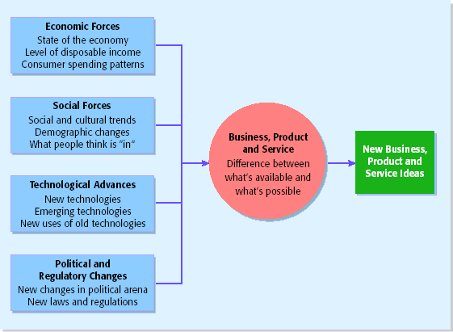
How Are Opportunities Identified?
Environmental Trends Suggesting Business, Product and Service Opportunity Gaps.
First Approach: Observing Trends

Slide 38
How are opportunities identified?
New operating practices – McDonald
New ways of delivery – DELL
New information ways – Benneton / Internet
New internal organisations – Ford / Oticon
New external organisations – Saatchi & Saatchi
New products and services - Martin Gruppen

Slide 39
Trend 1: Economic Forces
Economic Forces
  Economic forces affect consumers’ level of disposable income.
  When studying how economic forces affect opportunities, it is important to evaluate who has money to spend and who is trying to cut costs.
    An increase in the number of women in the workforce and their related increase in disposable income was one of the factors that led the founders of buyandhold.com to target women.
    Many large firms are trying to cut costs. Entrepreneurs have taken advantage of this trend by starting firms that help other firms control costs.

Slide 40
Trend 2: Social Forces
Social Forces
  Changes in social trends provide openings for new businesses on an ongoing basis.
  The continual proliferation of fast-food, for example, isn’t happening because people love fast food. It is happening because people are busy, and have disposable income.
  Similarly, the Sony Walkman was developed not because consumers wanted smaller radios but because people wanted to listen to music while on the go.

Slide 41
Trend 2: Social Forces [continued]
Examples of Social Forces That Allow For New Business Opportunities
Family and work patterns
The aging of the population
The increasing diversity in the workplace
The globalization of industry
The increasing focus on health care and fitness
The proliferation of computers and the Internet
The increase in the number of cell phone users
New forms of entertainment

Slide 42
Trend 3: Technological Advances
Technological Advances
  Given the rapid pace of technological change, it is vital that entrepreneurs keep on top of how new technologies affect current and future business opportunities.
  Entire industries have emerged as the result of technological advances.
    Examples include the computer industry, the Internet, biotechnology, and digital photography.
  Once a technology is created, new firms form to take the technology to a higher level.
    For example, RealNetworks was started to add audio capability to the Internet.

Slide 43
Trend 4: Political Action and Regulatory Changes
Political Action and Regulatory Changes
  Political action and regulatory changes provide the basis for new business opportunities.
  For example, laws that protect the environment have created opportunities for entrepreneurs to start firms that help other firms comply with environmental laws and regulations.

Slide 44
How Are Opportunities Identified?
(1 of 2)
Second Approach: Solving a Problem
Sometimes identifying
opportunities simply
involves noticing a problem
and finding a way to
solve it
These problems can be
pinpointed through observing
trends and through more simple
means, such as intuition,
or chance
Some business ideas are clearly
initiated to solve a problem
For example, Symantec Corp.
created Norton antivirus
software to guard computers
against viruses

Slide 45
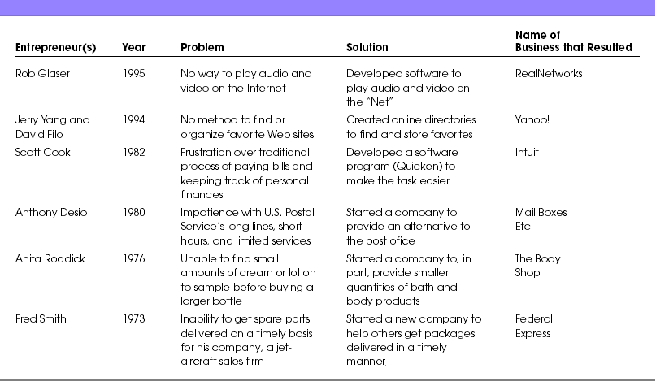
How Are Opportunities Identified?
(2 of 2)
Businesses Created to Solve a Problem

Slide 46
Personal Characteristics of the Entrepreneur
Characteristics that tend to make some people better at recognizing opportunities than others
Prior Experience
Social Networks
Cognitive Factors
Creativity

Slide 47
Prior Experience
Prior Industry Experience
  Several studies have shown that prior experience in an industry helps an entrepreneur recognize business opportunities. There are several explanations for this.
    By working in an industry, an individual may spot a market niche that is underserved.
    It is also possible that by working in an industry, an individual builds a network of social contacts who provide insights that lead to new opportunities.

Slide 48
Cognitive Factors
Cognitive Factors
  Studies have shown that opportunity recognition may be an innate skill or cognitive process.
  Some believe that entrepreneurs have a “sixth sense” that allows them to see opportunities that others miss.
  This “sixth sense” is called entrepreneurial alertness, which is formally defined as the ability to notice things without engaging in deliberate search.

Slide 49
Social Networks
(1 of 3)
Social Networks
  The extent and depth of an individual’s social network affects opportunity recognition.
  People who build a substantial network of social and professional contacts will be exposed to more opportunities and ideas than people with sparse networks.
  In one survey of 65 start-ups, half the founders reported that they got their business idea through social contacts.
Strong Tie vs. Weak Tie Relationships
  All of us have relationships with other people that are called “ties.” (See next slide.)

Slide 50
Social Networks
(2 of 3)
Nature of Strong-Tie Vs. Weak Tie Relationships
  Strong-tie relationship are characterized by frequent interaction and form between coworkers, friends, and spouses.
  Weak-tie relationships are characterized by infrequent interaction and form between casual acquaintances.
Result
  It is more likely that an entrepreneur will get new business ideas through weak-tie rather than strong-tie relationships. (See next slide.)

Slide 51
Social Networks
(3 of 3)
Why weak-tie relationships lead to more new business ideas than strong-tie relationships
Strong-Tie Relationships
Weak-Tie Relationships
These relationships, which typically form between like minded individuals, tend to reinforce insights and ideas that people already have
The relationships, which form between casual acquaintances, are not as apt to be between like-minded individuals, so one person may say something to another that sparks a completely new idea

Slide 52
Creativity
(1 of 2)
Creativity
  Creativity is the process of generating a novel or useful idea.
  Opportunity recognition may be, at least in part, a creative process.
  For an individual, the creative process can be broken down into five stages, as shown on the next slide.

Slide 53
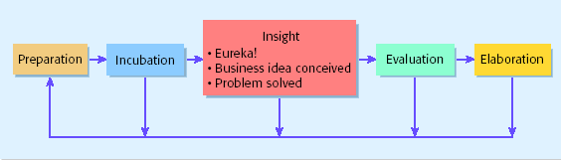
Creativity
(2 of 2)
Five-Steps to Generating Creative Ideas

Slide 54
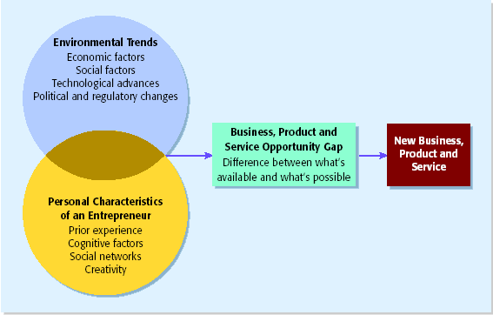
Full View of the Opportunity Recognition Process
Depicts the connection between an awareness of emerging trends and the personal characteristics of the entrepreneur

Slide 55
Protecting Ideas From Being Lost or Stolen
Step 1
  The idea should be put in a tangible form such as entered into a physical idea logbook or saved on a computer disk, and the date the idea was first thought of should be entered.
Step 2
  The idea should be secured. This may seem like an obvious step, but is one that is often overlooked.
Step 2
  Avoid making an inadvertent or voluntary disclosure of an idea, in a manner that forfeits the right to claim exclusive rights to it.

Slide 57
Essential Recommended Books
Schaper M. & Volery T. (2007) Entrepreneurship and Small Business: 2nd Pacific Rim edition John Wiley, Australia (ISBN 9780 4708 1082 8)

Slide 58
Question and Answer Session
Q & A

Slide 59
Merci Beaucoup
Thank You!

Slide 60
Recommended Books
[Reference Only]
Kuratko (2009) Introduction to Entrepreneurship 8th Edition. South Western (ISBN 13: 978 0 324 590869 ISBN10: 0 324 59086 5)

Slide 61
Recommended Books
[Reference only]
Birley S. & Muzyka D. (1997) Mastering Enterprise (Financial Times). Pitman Publishing (ISBN 0 273 63031 8)
Bridge S, Oneill K. & Cromie S (2003) Palgrave Macmillan (ISBN 0 33 98465 X)
Deakins D. & Freel M. (2003) Entrepreneurship and Small Firms. Publisher: McGraw Hill (ISBN 0 07 709993 1)
Sara S. (2003) Small Business Guide. 16th edition. Press Vitesse. (ISBN 0 954 0812 0)
Lewicki, R. Saunders, D. & Minton, (2001), Negotiation, Irwin McGraw-Hill, Singapore.

