Slide 1
Android operating system
TP020975 - Antonin LAPICHE

Slide 2
Contents
1
Introduction
2
Process Control Management
3
Deadlock Management
4
Memory Management

Slide 3
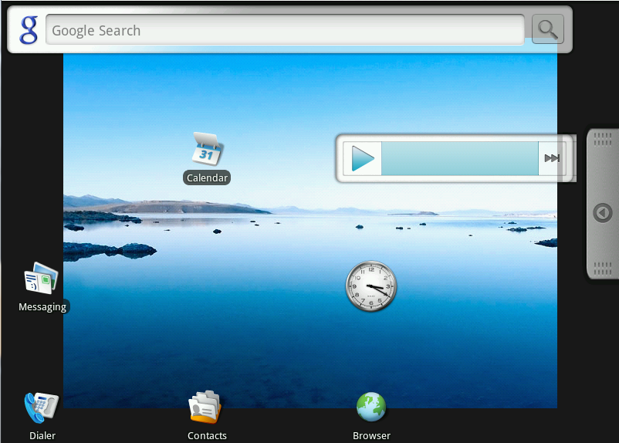
Introduction
Android is a Linux 2.6.29 (latest release) based operating system
It’s an open source operating system mainly developed for smartphones

Slide 4
Process Control Management : CFS
 | Process | Time(ns) | Priority |  | Fair Clock(ns) |  | T = 16 ns
 | P1 | 10 | 1 |  | 5,333333333 |  | n = 3
 | P2 | 4 | 2
 | P3 | 2 | 3
1 FC | 1 FC | 1 FC | 1 FC | 1 FC | 1 FC | 1 FC | 1 FC | 1 FC | 1 FC | 1 FC | 1 FC | 1 FC | 1 FC | 1 FC
↔ | ↔ | ↔ | ↔ | ↔ | ↔ | ↔ | ↔ | ↔ | ↔ | ↔ | ↔ | ↔ | ↔ | ↔
P1 | P1 | P2 | P3 | P2 | P1 | P2 | P3 | P1 | P1 | P2 | P3 | P1 | P3 | P3
0,00 | 5,33 | 8,89 | 11,26 | 12,84 | 13,89 | 14,60 | 15,06 | 15,38 | 15,58 | 15,72 | 15,82 | 15,88 | 15,92 | 15,95 | 16 ns

Slide 5
Deadlock Management : Prevention
A
1
Process
Resource
B
2
Process holds Resource
Process requires Resource
Deadlock
Hold and Wait: Processes already holding resources (or not) may require new resources or may require several resources.
Circular Wait: Two or more processes form a circular chain where each process waits for a resource that the next process in the chain holds.
Mutual Exclusion: Resource can only be used by one process at a time.
No preemption: Resource can’t be released by any other thing that the holding process

Slide 6
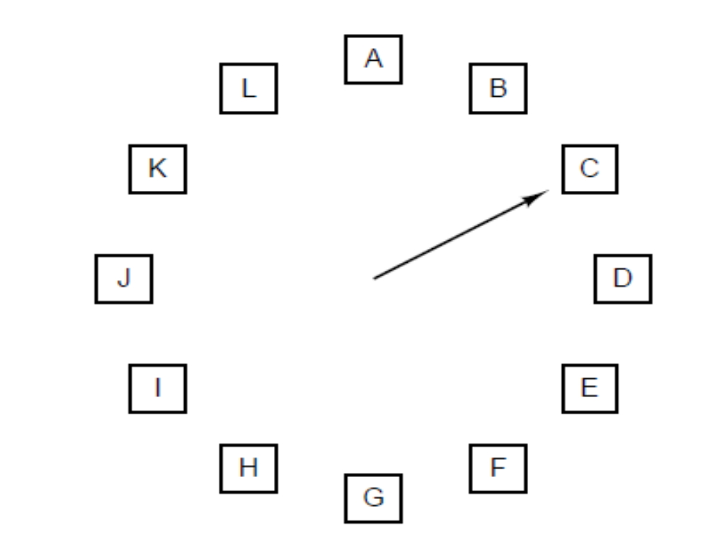
Memory Management : Clock
Time | 0 | 1 | 2 | 3 | 4 | 5 | 6 | 7 | 8 | 9 | 10
Requests |  | C | A | D | B | E | B | A | B | C | D
0 | A | A | A | A | A | E | E | E | E | E | D
1 | B | B | B | B | B | B | B | B | B | B | B
2 | C | C | C | C | C | C | C | A | A | A | A
3 | D | D | D | D | D | D | D | D | D | C | C
Page faults | 0 | 0 | 0 | 0 | 0 | 1 | 1 | 2 | 2 | 3 | 4
1 | A |  | 1 | E |  | 1 | E |  | 1 | E |  | 1 | E |  | 1 | E |  | 1 | D
1 | B | X5 | 0 | B |  | 1 | B |  | 0 | B |  | 1 | B |  | 1 | B |  | 0 | B
1 | C |  | 0 | C |  | 0 | C |  | 1 | A |  | 1 | A |  | 1 | A |  | 0 | A
1 | D |  | 0 | D |  | 0 | D |  | 0 | D |  | 0 | D |  | 1 | C |  | 0 | C

Slide 7
Thank You !

